Slide 1



Ironhack
Payments
Maria Aguilar, Nancy, Patricia Giménez, Taynã Appel

Slide 2

Exploratory Data Analysis (EDA) Report
01
02
03
04
Objective of the EDA
Dataset Overview
Key Distributions & Visualizations
Key Insights and Analysis
05
06
Data Quality
Observations & Limitations

Slide 3

01
Objective of the EDA
The goal of the Exploratory Data Analysis (EDA) is to gain an initial understanding of the structure, content, and patterns within the dataset. Before performing the cohort analysis, it is essential to explore the data to:
Understand how users interact with Ironhack Payments’ cash advance services.
Identify trends in user activity over time.
Examine the distribution of request statuses and amounts.
Detect potential outliers or unusual behavior in user transactions.
Highlight any early indicators of service engagement or drop-off.
This step also provides valuable context for designing the cohort segmentation logic and helps ensure the quality and reliability of the data used in subsequent analysis.

Slide 4

02
Cash Advance Requests
Contains individual records of cash advance requests made by users.
Rows: Each row represents a single cash request.
Key columns:
id: Unique ID for the cash request
user_id: ID of the user who made the request
amount: Amount requested
status: Status of the request (e.g., accepted, rejected)
created_at: Timestamp when the request was created
reimbursement_date: Date the user is expected to repay
transfer_type: Type of transfer (e.g., regular)
money_back_date: Date the money was returned (if applicable)
Together, these datasets provide a comprehensive view of user behavior, transaction activity, and the resulting revenue or service incidents. This overview informs the design of the cohort analysis.
Dataset Overview
Fees and Incidents
Contains financial and operational information related to the cash requests, including fees and incident records.
Rows: Each row represents a fee or incident linked to a cash request.
Key columns:
id: Unique ID for the fee/incident
cash_request_id: ID of the related cash request
type: Type of record (e.g., instant_payment, incident)
status: Status of the fee/incident
total_amount: Fee amount charged (used to calculate revenue)
category: Incident type, if applicable
created_at: Timestamp of fee creation
paid_at: Date the fee was paid

Slide 5
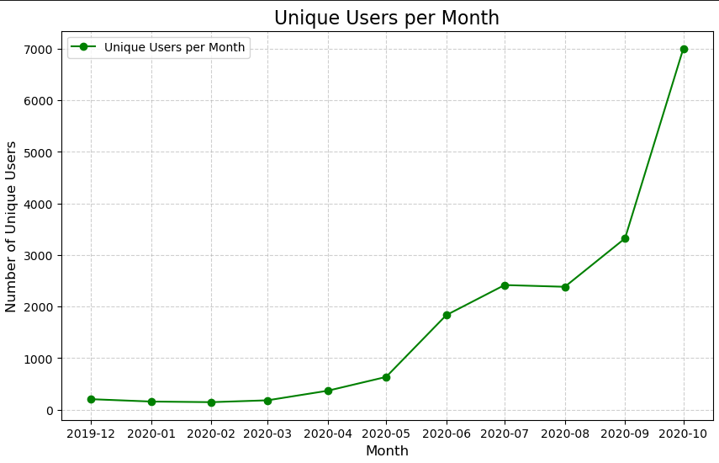
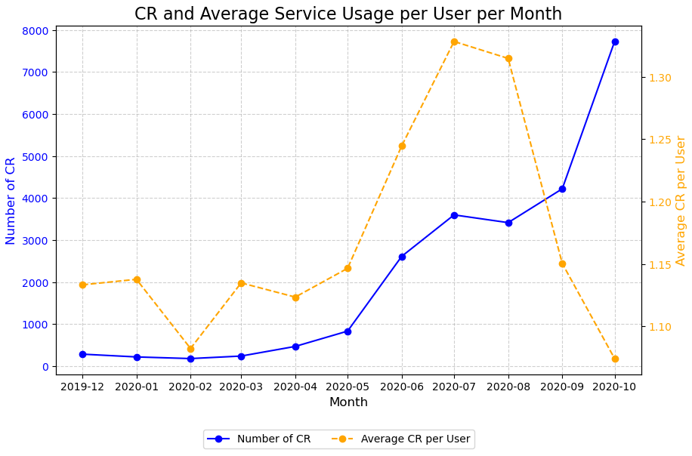
03
Key Distributions & Visualizations
A good indicator of service performance is the calculation of Cash Request per month. When this was calculated we wanted to go deeper to understand if the increase in CR was due to an increase of users or an increase of the amount of CR per user.
The graphs show both tendency for users and cash requests with the same distribution.
And this also reflect the increase in CR being mainly due to an increase in users (new users using our service).
For example, between July and August the amount of cash request decreased, but in this case was because the number of CR per user decreased (no new users during this period).

Slide 6
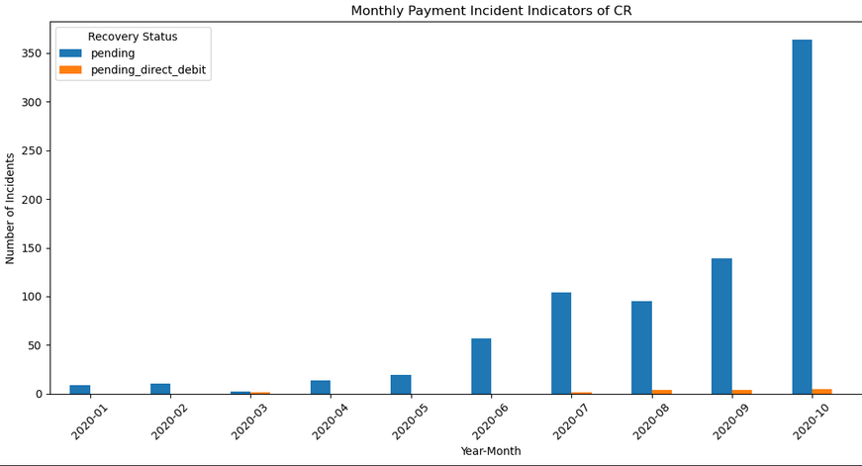
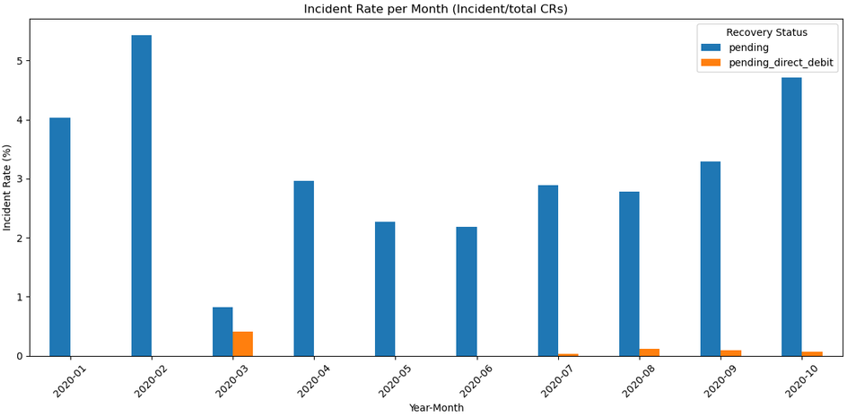
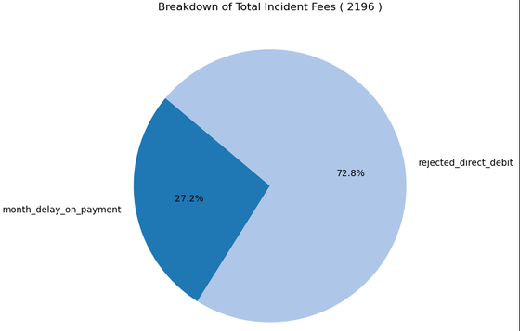
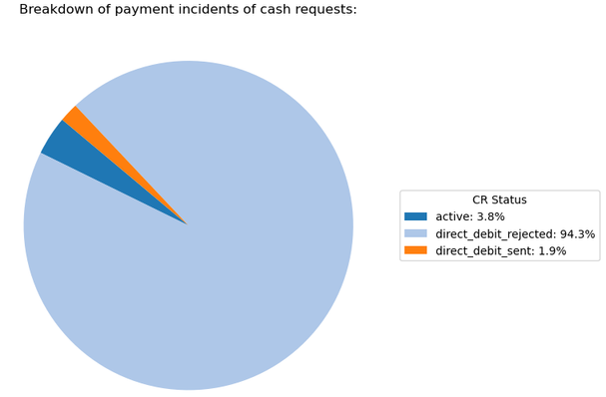
03
Key Distributions & Visualizations
For the business to be suistainable, it is necessary to have an insight into the incidence rate of customer loan reimbursments.
In the top graph we can see that the amount of payment incidents is increasing due to the higher amount of cash requests/users and a “constant” incident rate.

Slide 7
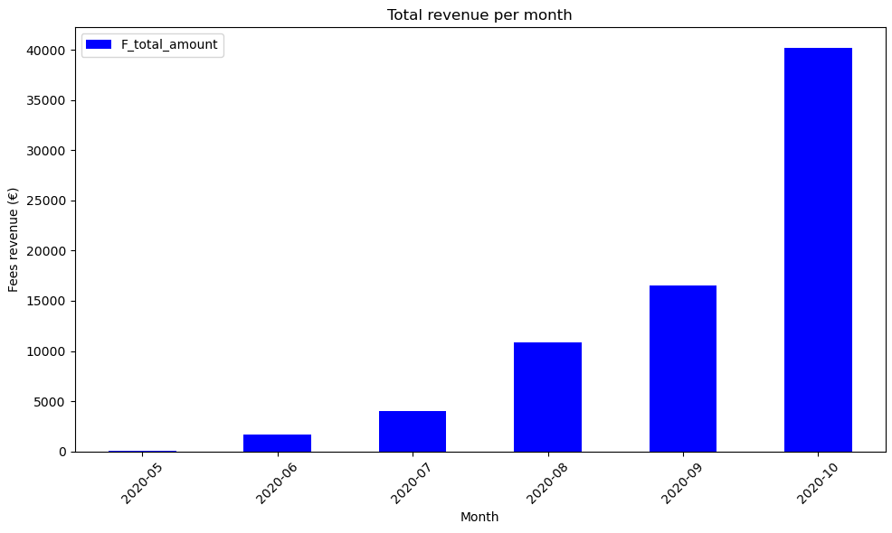
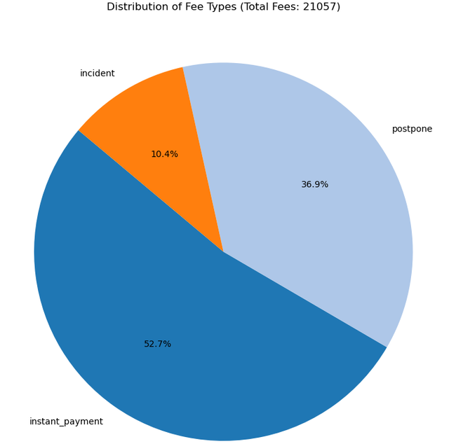
03
Key Distributions & Visualizations
Analyzing the distribution of total revenue fee amounts per month throughout the year was important to check growth or decline trends and to test other hypotheses about what could be affecting Ironhack's growth.
Hypothesis: This analysis showed that October was responsible for the higher fees revenues, following the trend analyzed before on user growth.
We also analyzed what kind of fees provided the higher total amounts of revenues. In that way, we can understand weather to charge higher or lower fees depending on their frequencies and returns.

Slide 8
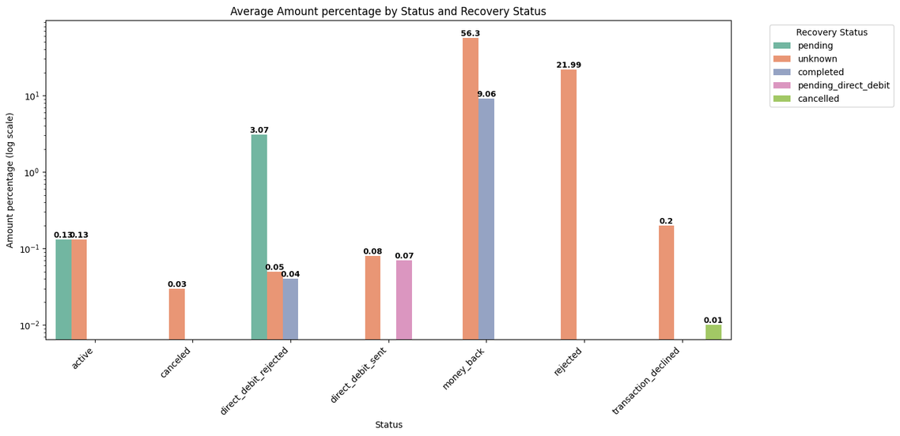
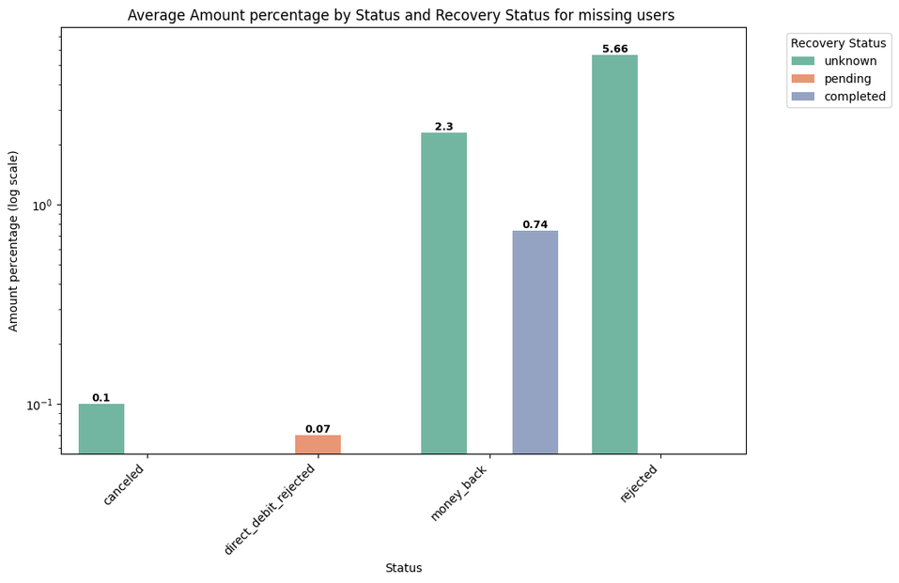
03
Key Distributions & Visualizations
Revenue distribution
Missing users
~91% amount is tagged with users
~9% amount is mapped with deleted users
Status
~68% of amount is returned : (65+3)
~27% of amount is rejected :(22+5)
~5% is due payment
Assumption: all unknown recovery status are same as status

Slide 9
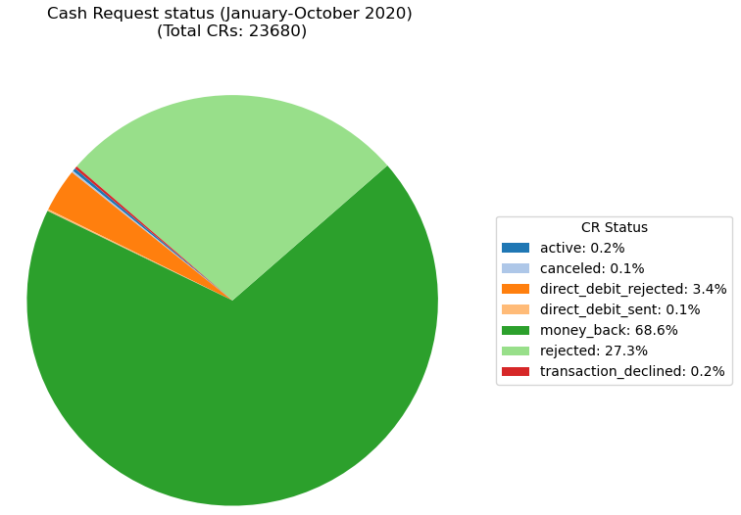
Data Visualization & Analysis
CR status indicators for the year
~27% Cash requests are rejected with unkown reasons
Why?

Slide 10
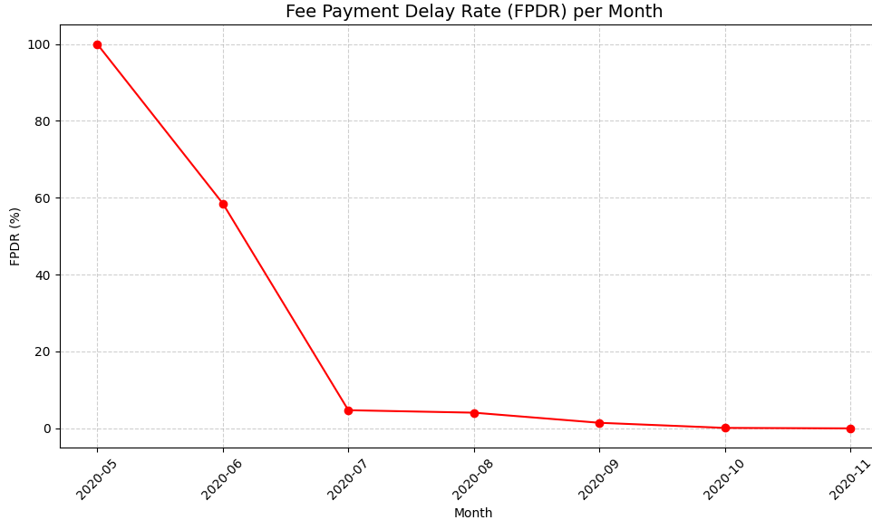
Data Visualization & Analysis
Fee Payment Delay Rate (FPDR) per Month
To ensure the sustainability of the platform, it is important to understand how users behave after accepting service fees. The Fee Payment Delay Rate (FPDR) helps us measure the percentage of accepted fees that remain unpaid over time.
This metric allows us to evaluate whether users who agree to pay a fee actually follow through, which is crucial for revenue stability and user trust.
In the early stages (e.g., May 2020), we observed a high FPDR. This is likely due to the launch of the platform, where payments were pending or still in processing. Over the following months, the FPDR steadily declined, suggesting improved user compliance and system maturity.
A decreasing FPDR is a positive signal: it indicates that users are paying their accepted fees more consistently, and the platform is becoming more reliable in terms of fee recovery.
Contrary to the initial hypothesis, the Fee Payment Delay Rate (FPDR) has significantly decreased over time, even as service usage increased.
This suggests a positive evolution in user payment behavior and potentially better platform processes or communication.
Hypothesis:
As service usage increases, the percentage of unpaid accepted fees might also increase, revealing possible liquidity problems or decreasing user engagement.
FPDR (%) = (accepted fees with no paid_at date) / (Total Accepted Fees) * 100

Slide 11
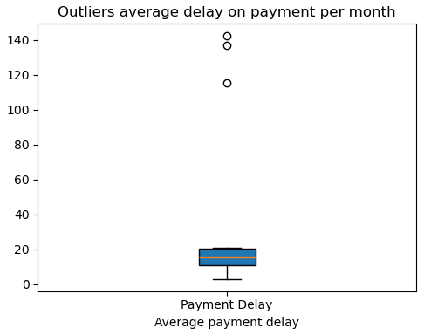
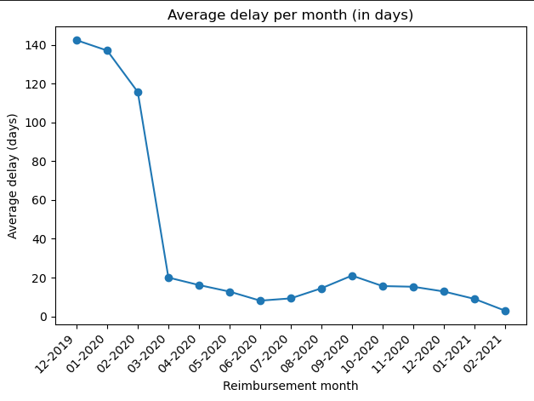
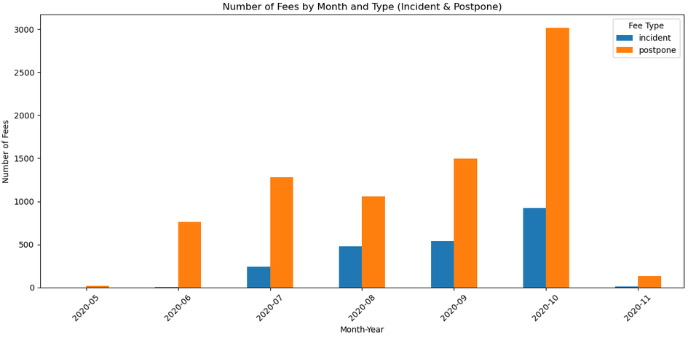
Data Visualization & Analysis
Only money back CR and late payments are considered
Delay con Cash Request Reimbursement

Slide 12

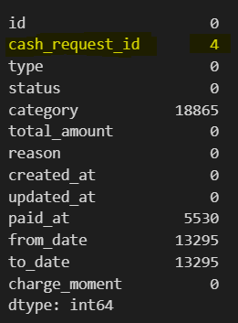
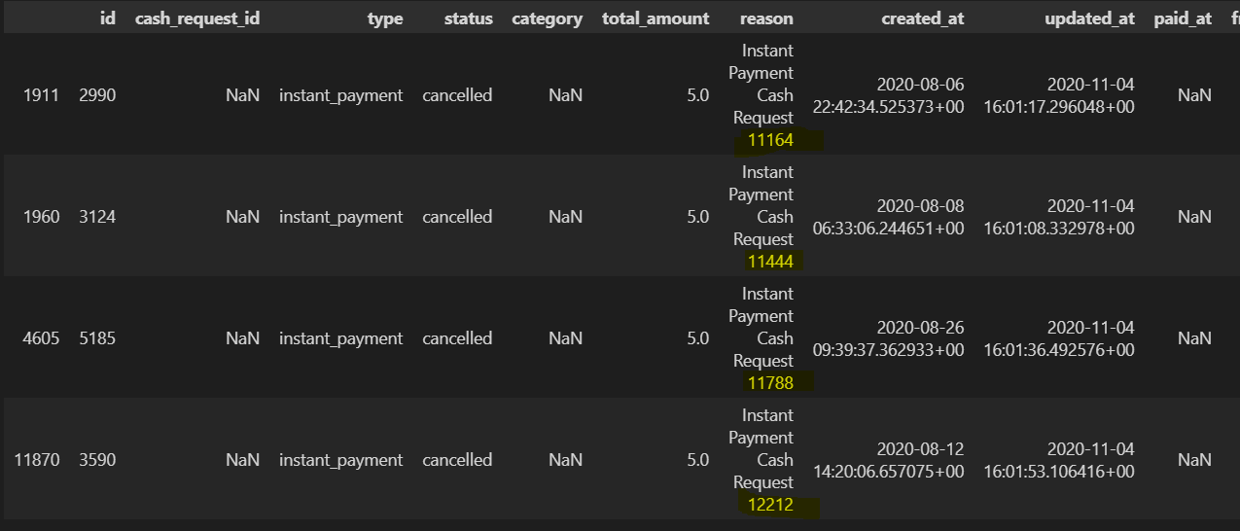
05
Data Quality
Some missing values of Cash Request in the fees information.
Solution: Completing data with the information of the id found in the reason column

Slide 13
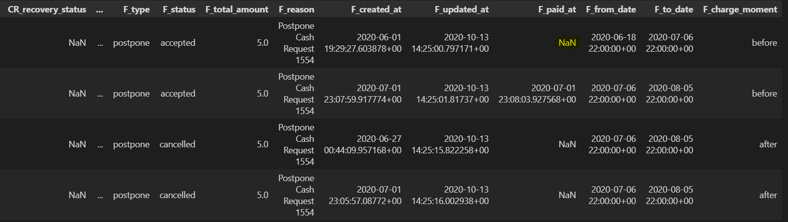
05
Data Quality
2. Some missing paid fees date when fee is accepted (financial department). We assumed fee is paid but the data is missing.
In this example, fee paid_at column is missing the date. However F_status is accepted and F_charge_moment is set as “before”.

Slide 14
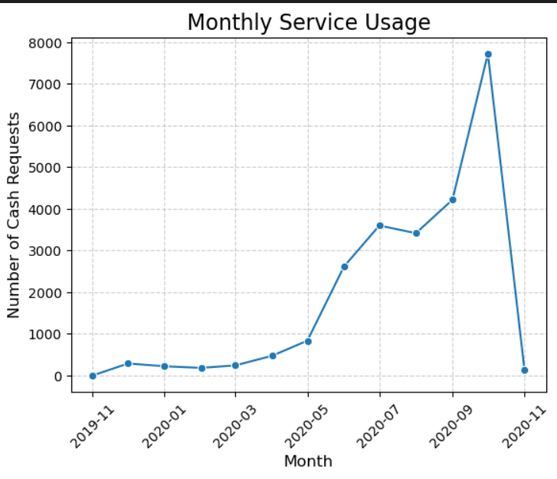
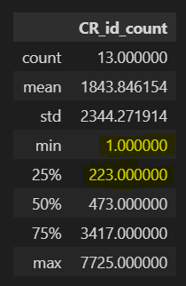
05
Data Quality
3. First and last month of the dataset were not fully completed with data, so we removed them for the analysis.

Slide 15
05
Data Quality
4. All date fields appeared to be in a specific datetime format and for the analysis we should:
Standardize time zones or remove for consistency.
Columns like created_at, updated_at, and paid_at need to be converted to datetime types.
5. Duplicates were also checked to make sure we would have the correct amount of users and guarantee data quality.

Slide 16
06
Observations &
Limitations
Point 01
There are sufficient events per user so It’s Ideal for our cohort analysis, but understanding the data was our big challenge to the analysis
Point 02
We could have more data on the users to make further analysis as modelling risk per profile of each user or region etc.
Point 04
To understand seasonality of the cash requests more data is required
Point 05
Data structure could be simplified and improve, we can’t see different stages of CR_status as it is a live variable
Point 06
We missed more information on the reasonability behind the status of requests rejected and the recovery status.

Slide 17
SLIDES FOR PRESENTATION --------->

Slide 18
Ironhack
Payments
Maria Aguilar, Nancy, Patricia Giménez, Taynã Appel

Slide 19

Data Analysis Process
Cleaning/quality
EDA
Report
Make sure our data has quality, It’s properly clean and will provide accurate information to the analysis. We should check for missing values, outliers, inconsistencies ....
In order to properly do that, we start cleaning the databases while we investigate and understand the meaning of each variable and how they are impacting each other, properly exploring the data and being able to create hypothesis (aligning with the cleaning of it)...
And finally we can provide Insights and raise some analytical solutions to our raised hypothesis. In our report we were able to explain each step on the way, to make sure the full picture was provided.

Slide 20
Data Quality Review
Identifying issues and cleaning process
Some missing values of Cash Request in the fees information.
Solution: Completing data with the information of the id found in the reason column.
Some missing paid fees date when fee is accepted (financial department).
Solution: Flag the problem to the finance team and drop the lines that are not consistent
First and last months of the dataset were not fully filled with data.
Solution: we removed them for the analysis.
All date fields appeared to be in a unconsistent datetime format
Solution: errors were handled and all formats were considered.
5. Duplicates were also checked to guarantee data quality.

Slide 21
Data Visualization & Analysis
Frequency of Service Usage
Service performance --> calculation of Cash Request per month. Understand if the increase in CR was due to an increase of users or an increase of the amount of CR per user.
The graphs show both tendency for users and cash requests with the same distribution.
And this also reflect the increase in CR being mainly due to an increase in users (new users using our service).
For example, between July and August the amount of cash request decreased, but in this case was because the number of CR per user decreased (no new users during this period).

Slide 22
Data Visualization & Analysis
Incident Rate
Sustainability of the business⟶ demands insights into the incidence rate of customer loan reimbursements.
In the top graph we can see that the amount of payment incidents is increasing due to the higher amount of cash requests/users and a “constant” incident rate.

Slide 23
Data Visualization & Analysis
Revenue Generated by the Cohort
Analysis of the distribution of total revenue fee amounts per month throughout the year
⟶ Check growth or decline trends and test other hypotheses about what could be affecting Ironhack's growth.
Hypothesis: This analysis showed that October was responsible for the higher fee revenues, following the trend analyzed before on user growth.
We also analyzed what kind of fees provided the higher total amounts of revenues. In that way, we can understand weather to charge higher or lower fees depending on their frequencies and returns.
~53% of fees revenues comes from instant_payment (increase in revenue by little increase for the fee)

Slide 24
Data Visualization & Analysis
Only money back CR and late payments are considered
Metrics to understand
Looks like the company announced fees for incidents on february 2020 and decreased the average delay on payments as no fees are recorded till May.
From November 2021 is either not enough fees data or users are behaving :)

Slide 25
Data Visualization & Analysis
Fee Payment Delay Rate (FPDR) per Month
The Fee Payment Delay Rate (FPDR) helps us measure the percentage of accepted fees that remain unpaid over time.
⟶ Evaluate whether users who agree to pay a fee follow through (revenue stability and user trust).
A decreasing FPDR is a positive signal: it indicates that users are paying their accepted fees more consistently, and the platform is becoming more reliable in terms of fee recovery.
Contrary to the initial hypothesis, the Fee Payment Delay Rate (FPDR) has significantly decreased over time, even as service usage increased.
⟶ Positive evolution in user payment behavior and potentially better platform processes or communication.
Hypothesis:
As service usage increases, the percentage of unpaid accepted fees might also increase, revealing possible liquidity problems or decreasing user engagement.
FPDR (%) = (accepted fees with no paid_at date) / (Total Accepted Fees) * 100

Slide 26
06
Point 01
There are sufficient events per user so It’s Ideal for our cohort analysis, but understanding the data was our big challenge to the analysis
Observations &
Limitations
Point 02
We could have more data on the users to make further analysis as modelling risk per profile of each user or region etc.
Point 04
To understand seasonality of the cash requests more data is required
Point 05
Data structure could be simplified and improve, we can’t see different stages of CR_status as it is a live variable
Point 06
We missed more information on the reasonability behind the status of requests rejected and the recovery status.
Point 07
Fees amount are the same regardless the type of fee

Slide 27

Thank You

